Slide 1
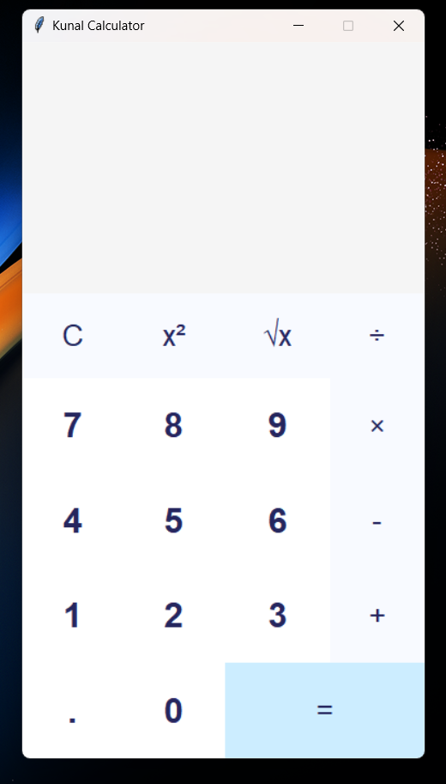
Project -1 GUI CALCULATOR USING PYTHON(TKINTER)
BY :- KUNAL SONTAKKE

Slide 2
GUI Calculator Overview
A calculator is a type of electronic calculator, usually but not always handheld, designed to calculate problems in science, engineering, and mathematics. They have completely replaced slide rules in traditional applications, and are widely used in both education and professional. The python calculator was implemented using tkinter to make the calculation of mathematical functions easier. The application consists of standard functions.

Slide 3
Tkinter Programming
Tkinter is the standard GUI library for Python. Python when combined with Tkinter provides a fast and easy way to create GUI applications. Tkinter provides a powerful object-oriented interface to the Tk GUI toolkit.
Creating a GUI application using Tkinter is an easy task. All you need to do is perform the following steps −
Import the Tkinter module.
Create the GUI application main window.
Add one or more of the above-mentioned widgets to the GUI application.
Enter the main event loop to take action against each event triggered by the user.

Slide 4
Defined Buttons:
Buttons are arranged in a grid layout and provided functionality for:
Digits (0-9): To Give Input Numbers .
Operations (+,*,/,-) : To perform basic arithmetic operations.
Special Operations (Sqrt,^2);For advanced calculation
Functional Button(=,C): To calculate resulta, or to cler display.

Slide 5
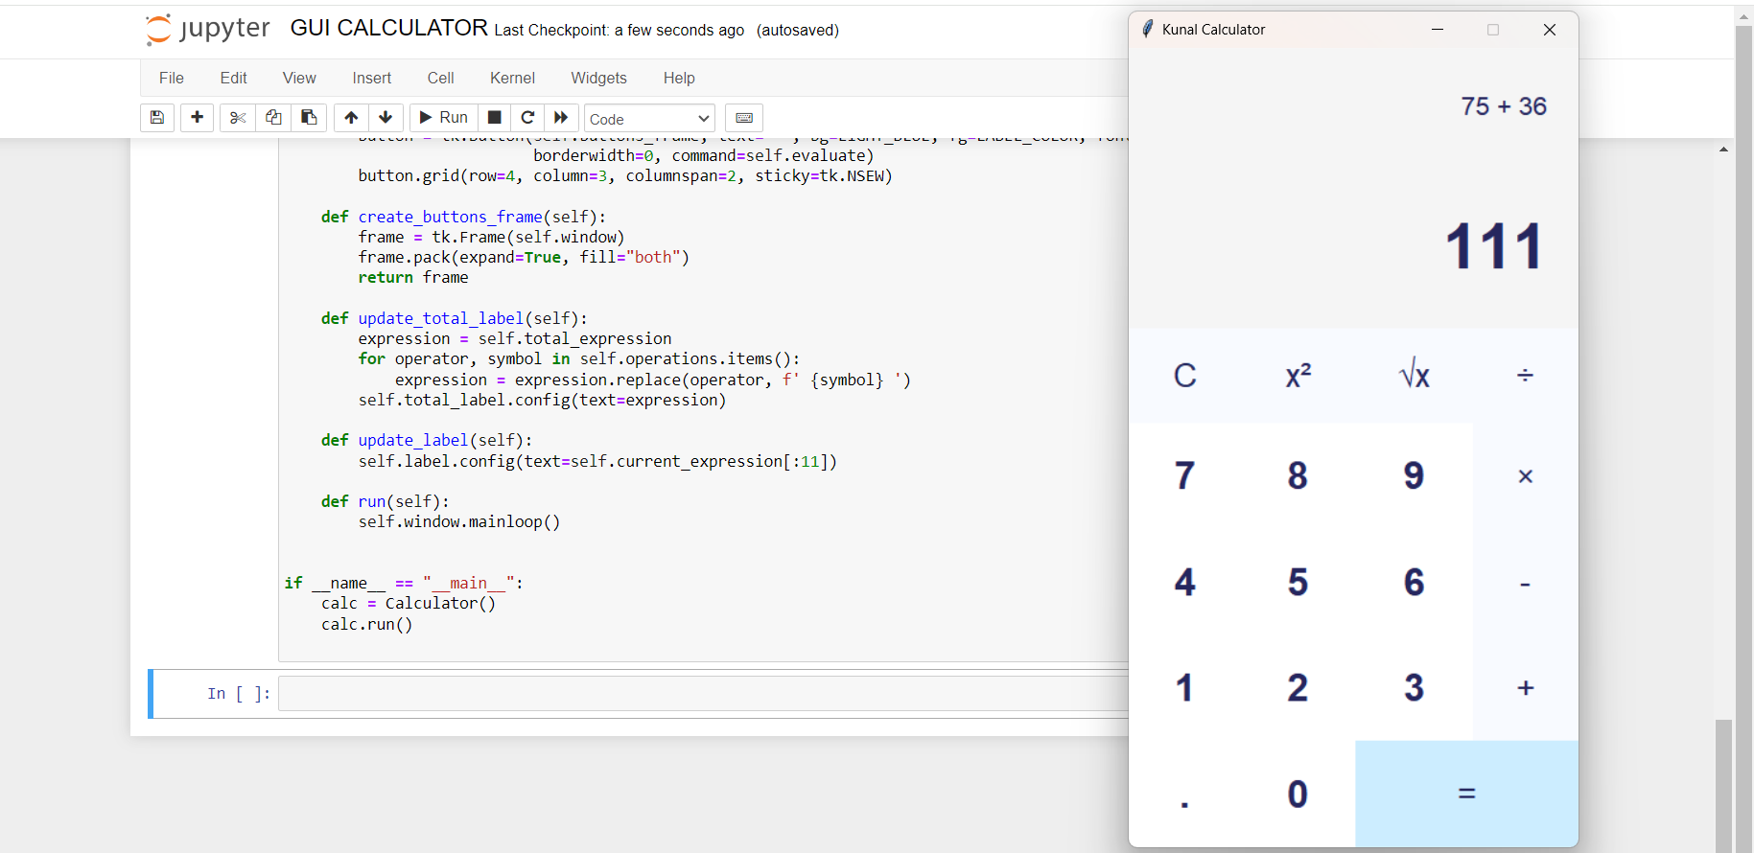
Python Code:

Slide 6
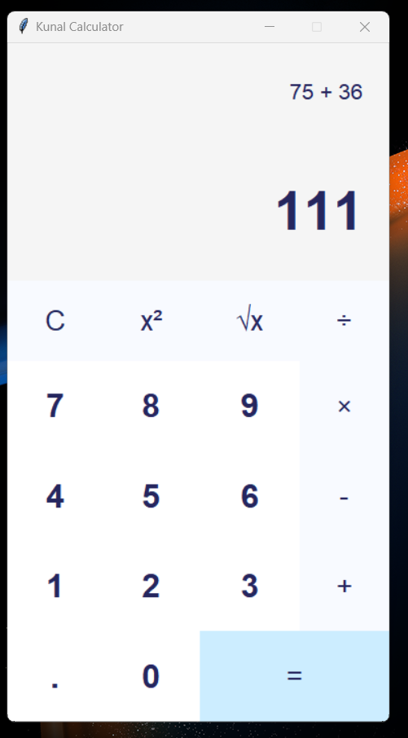
Output- Addtion

Slide 7
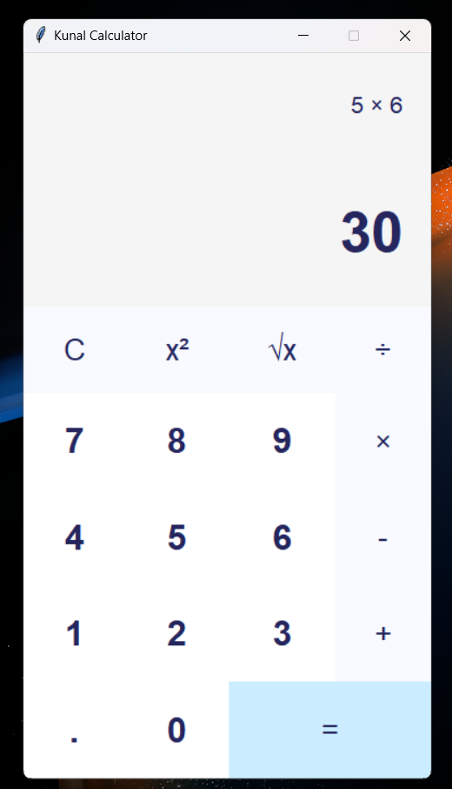
Output- Multiplication

Slide 8
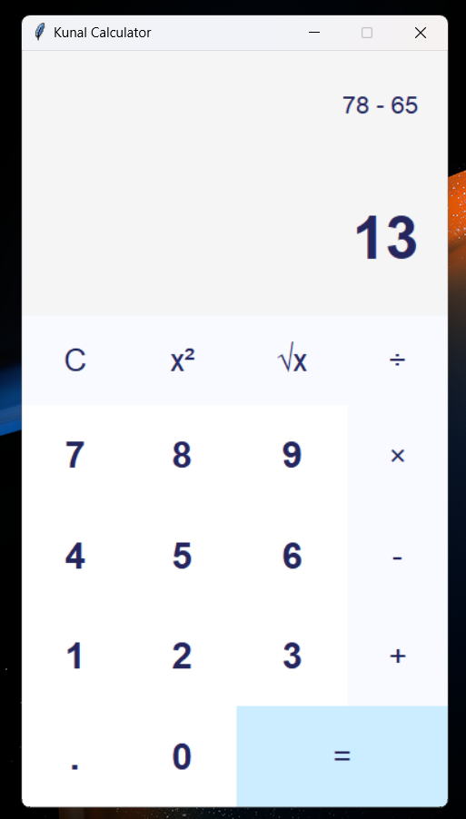
Output- Subtraction

Slide 9
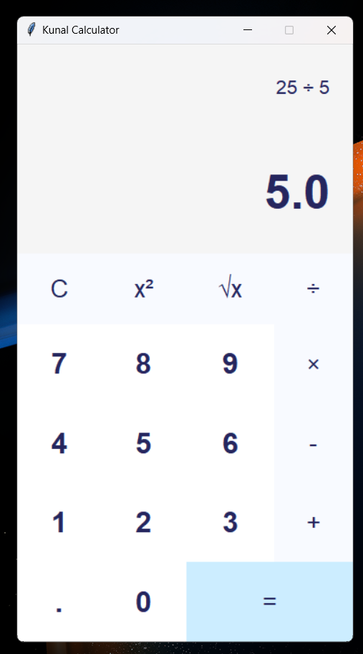
Output- Division

Slide 10
Conclusion:
The proposed system is error free. Trivial concepts of Python language are implemented into the system. As, the usage of Python Tkinter as the GUI provided various controls, such as buttons, labels, and text boxes to build a User friendly application.
Efficient Calculations
The rapid expansion and use of the internet, confirms the splendid future and scope of the project.

